Slide 1


भारतीय सूचना प्रौद्योगिकी संस्थान भागलपुर
Indian Institute of Information Technology Bhagalpur
(An Institute of National Importance Under Act of Parliament)
A Hybrid Approach of CNN-LSTM
for Speech Emotion Recognition

Slide 2


The Project Has been completed under the guidance of
Dr. Ravi Shankar Mehta
Group No. : 15
Project Title
Rajeev Ranjan (2101054CS)
Vivek Giri (2101024CS)
Shiv Datta Dixit (2101077CS)
Sourabh (2101049CS)

Slide 3

A Hybrid Approach of CNN-LSTM for Speech Emotion Recognition
Speech Emotion Recognition (SER) is a rapidly evolving field with significant implications for various applications, including human-computer interaction, mental health monitoring, and personalized education. The core challenge in SER lies in accurately classifying the emotional content conveyed through speech signals, which are complex and often nuanced. This complexity stems from the intricate interplay of acoustic features, linguistic content, and paralinguistic cues. Traditional methods often struggle to capture this multifaceted nature of emotion in speech. This paper explores a hybrid approach that integrates a 1-D Convolutional Neural Network (CNN) with Long Short-Term Memory (LSTM) architecture to address these challenges. By leveraging the strengths of both CNNs (for feature extraction from raw audio) and LSTMs (for capturing temporal dependencies within the speech signal), we aim for improved emotion classification accuracy and robustness.

Slide 4

The Importance of Speech Emotion Recognition
Social Media and the Internet
Paralinguistic Features
The rise of social media and the internet has created new opportunities for SER research due to the high volume of speech data generated daily and the ever-growing need to understand user emotions. Imagine analyzing customer service calls to identify frustrated customers or monitoring social media comments to gauge public sentiment towards a product launch. These applications demonstrate the potential of SER to improve user experience and inform business decisions.
SER systems heavily rely on supervised learning classifiers trained on meticulously labeled data. Feature extraction, a crucial preprocessing step, plays a pivotal role in transforming raw speech signals into meaningful representations. These features often include prosodic elements like pitch, intensity, and duration, as well as spectral characteristics reflecting the acoustic properties of the speech. Sophisticated algorithms then analyze these features to identify patterns indicative of specific emotions, enabling accurate classification and analysis.

Slide 5

Related Research and Approaches
1
Multimodal Emotion Recognition
2
Attention-Based Convolutional Recurrent Networks
Previous studies have explored multimodal emotion recognition systems that leverage both visual and auditory cues. These systems often utilize recurrent neural networks, particularly LSTMs, to process the raw data streams from cameras and microphones. The LSTM's ability to capture temporal dependencies within sequential data makes it particularly suitable for analyzing the dynamic nature of emotional expression in both speech and visual signals. Research in this area has focused on techniques for effectively fusing the information from different modalities and creating robust models that can handle noise and variability in the input data. The key challenge lies in finding an effective way to combine the heterogeneous information from different modalities to improve the accuracy of emotion recognition.
Another promising approach involves the use of 3-D attention-based convolutional recurrent neural networks (ACRNNs). These architectures combine the strengths of convolutional layers for feature extraction from spatial patterns within the data (e.g., spectrograms in speech analysis) and recurrent layers (LSTMs or GRUs) to capture temporal relationships and long-range dependencies. The attention mechanism is crucial here as it allows the model to focus on the most relevant parts of the input, weighting different features or time steps according to their importance in determining the emotional state. The 3-D nature of the convolution extends this to encompass both time and frequency dimensions, leading to a more comprehensive understanding of the input data. ACRNNs demonstrate superior performance in capturing subtle emotional nuances that may be difficult for simpler models to detect.
3
Attention-Based Bidirectional LSTM
The combination of attention-based bidirectional LSTM recurrent neural networks with attention-based fully convolutional networks represents a sophisticated approach to automatic speech emotion recognition (SER). Bidirectional LSTMs are effective in processing sequential data by considering both past and future context, while fully convolutional networks excel at feature extraction. The attention mechanism further enhances performance by focusing on the most informative features or time frames within the audio. This synergy allows the model to capture both short-term and long-term dependencies in the speech signals, leading to more accurate emotion classification. Research employing this technique has yielded significant improvements in accuracy compared to traditional methods, especially in datasets with complex and nuanced emotional expressions.

Slide 6
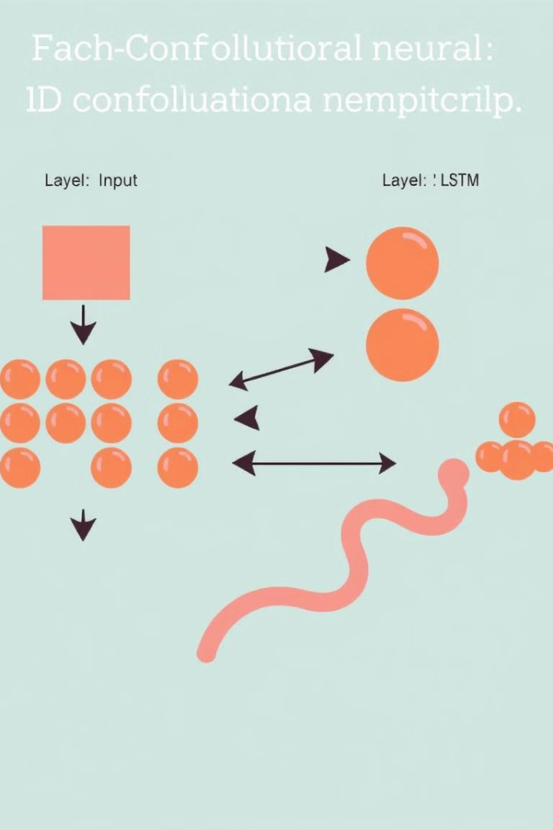
Proposed Approach: 1D-CNN and LSTM Model
Our model uses a hybrid 1D CNN-LSTM architecture for speech emotion recognition. Audio data is converted into mel spectrograms, providing a time-frequency representation. The 1D-CNN extracts spatial features, capturing short-term characteristics, while the LSTM layers model the temporal evolution of emotion. A final softmax layer predicts the dominant emotion.

Slide 7

Dataset Creation and Experimentation
To ensure a robust and diverse dataset for training and evaluation, we integrated data from four publicly available databases: CREMA-D, TESS, RAVDESS, and SAVEE. These databases were chosen for their diversity in emotional expression, speaker demographics, and recording quality. Our final dataset comprised approximately 600 speech files per emotion, resulting in a balanced representation of each emotional category. Before model training, we performed data cleaning to remove any noisy or corrupted samples. To address potential overfitting issues and enhance model generalizability, we also employed data augmentation techniques such as adding random noise and varying the speed of the audio clips. The final dataset was meticulously split into training, validation, and testing sets, maintaining a consistent proportion of samples across different emotions to ensure fair evaluation. This rigorous dataset construction process is crucial for achieving reliable and generalizable performance in speech emotion recognition.

Slide 8
Data Set Overview
RAVDESS
SAVEE
The Ryerson Audio-Visual Database of Emotional Speech and Song (RAVDESS) is a multimodal database featuring recordings from 24 actors, each expressing a diverse range of emotions. These emotions include disgust, sadness, calm, happiness, anger, surprise, and fear. The database is valuable for its balanced representation of emotions across multiple speakers, providing rich data for training emotion recognition models. The inclusion of visual data alongside audio also allows for the exploration of multimodal approaches to emotion recognition.
The Surrey Audio-Visual Expressed Emotion (SAVEE) database offers recordings from four native English male speakers, providing a more controlled dataset focusing on the nuances of emotion expression in a specific demographic. Emotions covered include surprise, anger, happiness, disgust, fear, sadness, and a neutral baseline. This targeted approach enhances the understanding of how emotional expression may vary based on speaker characteristics and cultural background. Its smaller size, compared to other datasets, makes it suitable for testing and comparing performance with larger and more diverse datasets.
CREMA-D
TESS
CREMA-D stands out with its considerable size, encompassing 7,442 original clips sourced from 91 actors. This emotional multimodal actor dataset offers a high volume of samples for robust model training. The emotions captured include anger, disgust, fear, happiness, neutral, and sadness. The large number of actors contributes to greater generalizability and helps mitigate the impact of individual speaker biases in the model's performance.
The Toronto Emotional Speech Set (TESS) provides 2800 audio files from two actresses, focusing on a smaller set of controlled expressions. The dataset is particularly valuable for its clarity and consistent recording quality. The seven emotions represented are: anger, disgust, fear, happiness, pleasant surprise, sadness, and neutral. The inclusion of two actresses allows for a limited investigation into gender-related differences in emotional expression, although it is crucial to recognize the limitations of generalizing from such a small sample of speakers.

Slide 9
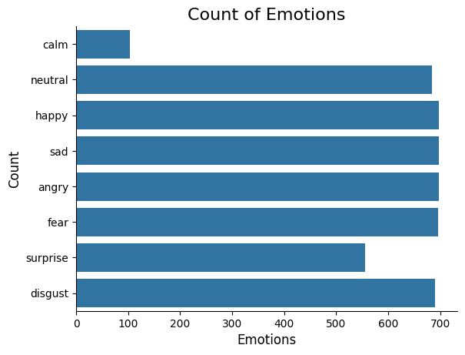
Description of Emotions
Happy: Positive emotion characterized by a cheerful tone.
Sad: Negative emotion marked by a slow and low-pitched tone.
Angry: Negative emotion with a loud, sharp, and high-pitched tone.
Fear: Emotion of alarm or anxiety, often with a trembling or shaky tone.
Surprise: Sudden emotion with a rapid change in pitch and intensity.
Disgust: Negative emotion with a harsh or irritated tone.
Neutral: Emotionless or calm tone, serving as a baseline.
Calm: Calm is the state of feeling peaceful, composed, and free from stress or agitation.
.
fig. Distribution of emotions

Slide 10
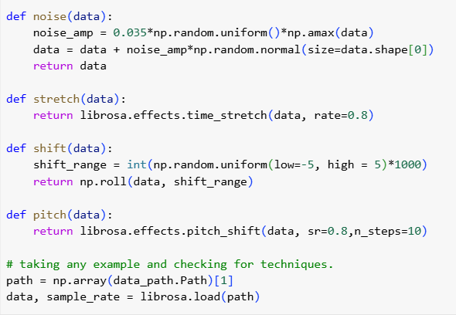
Data Augmentation
Data augmentation is a technique used to increase the diversity of data available for training machine learning models by creating new synthetic data from the existing data. It is particularly useful in scenarios where collecting and labeling large datasets is challenging or expensive. By applying various transformations to the original data, data augmentation helps in improving the model's generalization and robustness.
fig. Data augmentation techniques

Slide 11
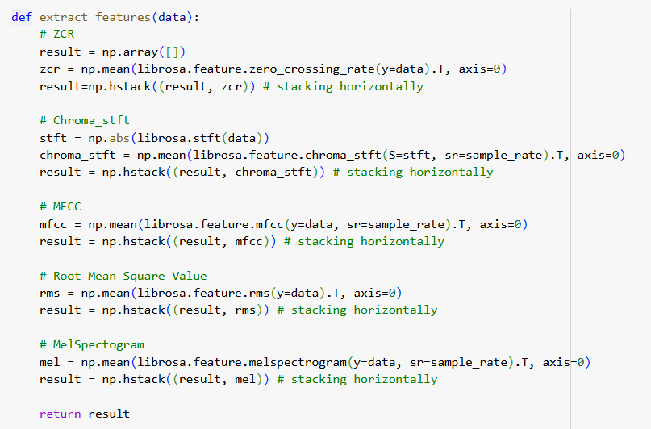
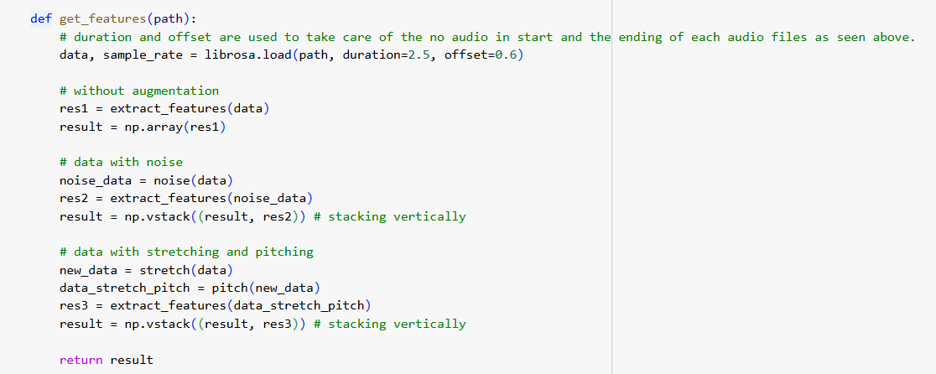
FEATURE EXTRACTION

Slide 12
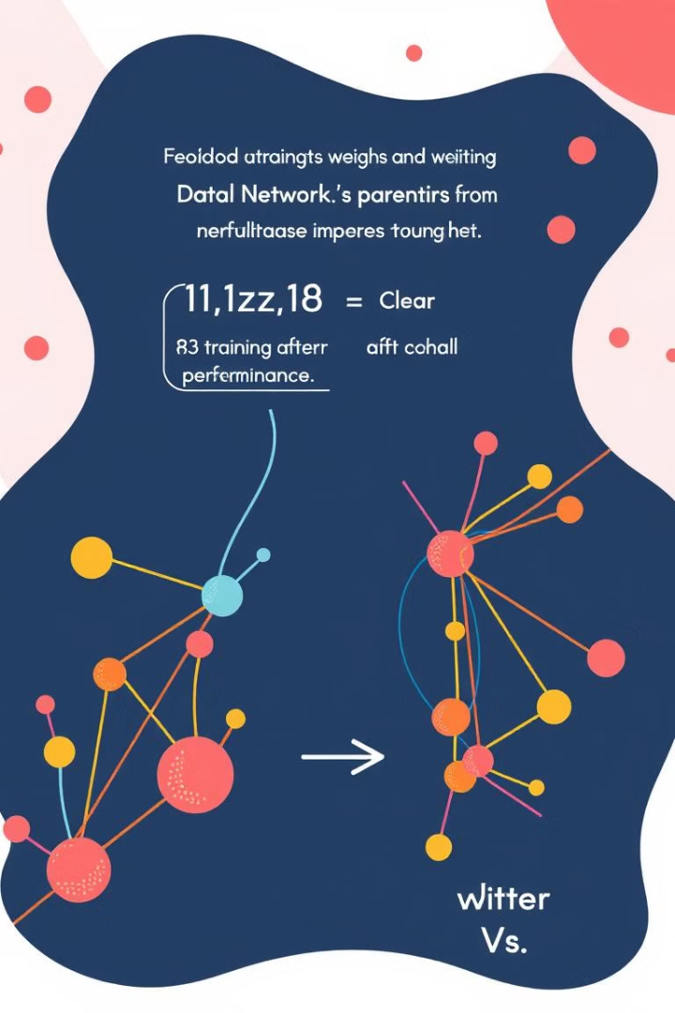
Model Training
The dataset was split into training, validation, and testing sets, typically using an 80/10/10 split or similar proportions. The model was trained on the training set using the Adam optimizer, known for its efficiency in handling high-dimensional data. The categorical cross-entropy loss function was employed, suitable for multi-class classification problems like speech emotion recognition. We monitored the model's performance on the validation set during training to prevent overfitting and to select the optimal number of epochs. Early stopping was implemented to halt training when the validation loss plateaued. Hyperparameter tuning was performed using grid search or random search, exploring different learning rates and batch sizes to further optimize performance.

Slide 13
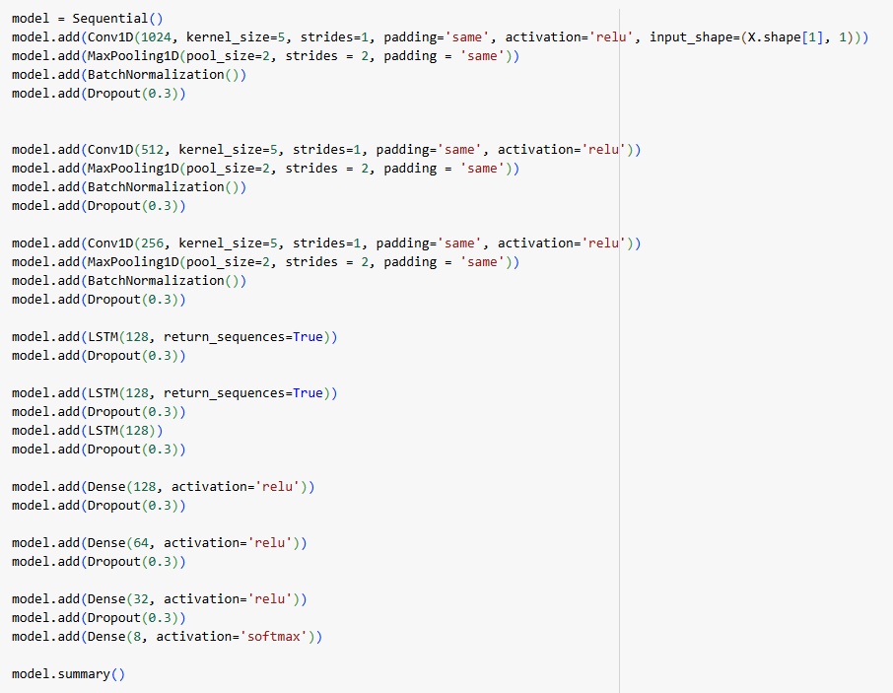
CNN-LSTM MODEL

Slide 14
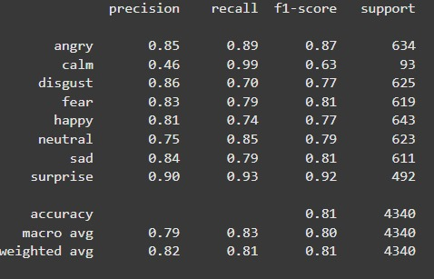

Evaluation
Once training was complete, the model's performance was rigorously evaluated on the held-out testing set using metrics such as accuracy, precision, recall, F1-score, and the confusion matrix to obtain a comprehensive understanding of its capabilities in classifying various speech emotions.
fig. Classification Report

Slide 15

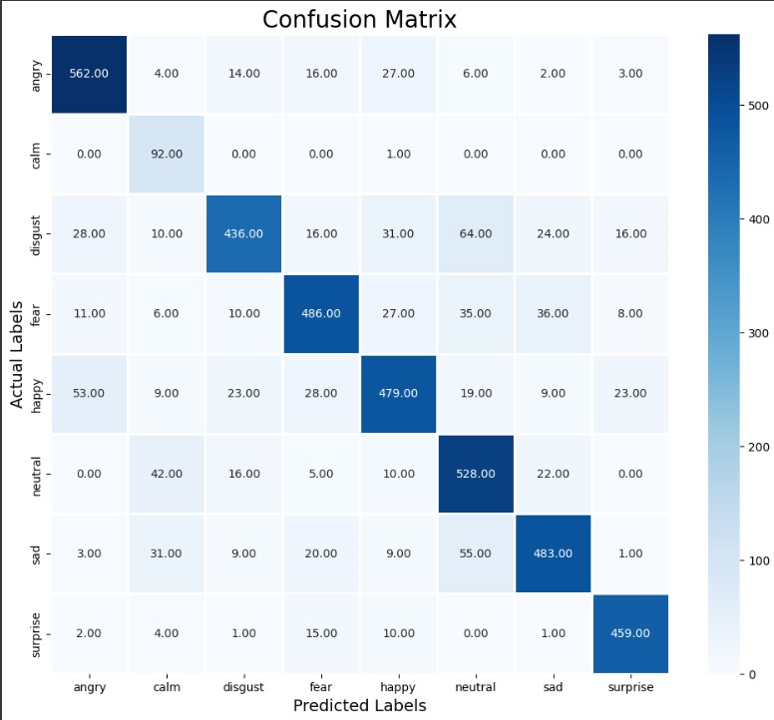
Results and Discussion
The project achieved an overall accuracy of approximately 81%, demonstrating the potential for further refinement. A more detailed breakdown reveals that the model performed exceptionally well in recognizing positive emotions (e.g., joy, happiness), achieving accuracies above 81%. However, discrimination between negative emotions such as anger and sadness proved more challenging, resulting in lower precision scores for those categories. This suggests areas for future improvement. Future efforts should concentrate on enhancing the model's precision, particularly in distinguishing between closely related negative emotions. This could involve exploring different feature extraction techniques, augmenting the dataset with more diverse examples of these emotions, or employing advanced regularization methods to prevent overfitting. Addressing these issues, including potential class imbalance in the dataset, could significantly advance the field of speech emotion recognition, leading to more robust and reliable systems.

Slide 16
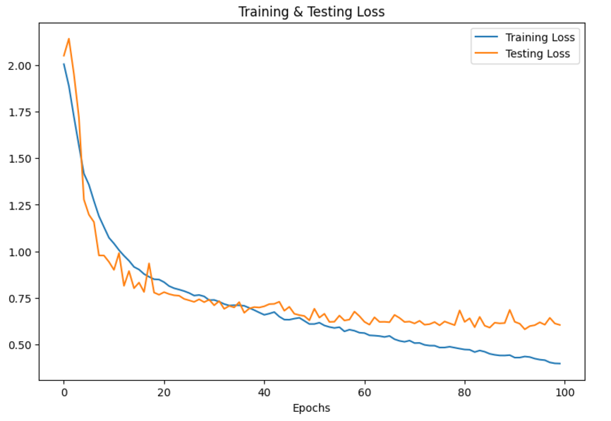
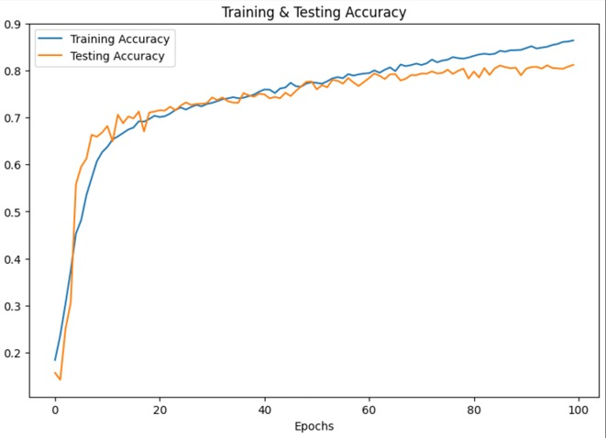
Accuracy
fig. Graph of epochs v/s Training & Testing Loss
fig. Graph of epochs v/s Training & Testing Accuracy

Slide 17

Conclusion and Future Directions
This study has made notable progress in SER using CNN. The results indicate a high potential for the model, and future efforts to develop a custom dataset and incorporate it into the training process could lead to further improvements and more precise emotion recognition. Future work could explore the integration of attention mechanisms within the LSTM layers to better focus on relevant parts of the speech signal. Investigating different deep learning architectures, such as transformers or hybrid models combining CNNs with transformer encoders, could also yield improved performance. Additionally, addressing potential limitations in the current dataset, such as class imbalance or lack of diversity in speakers, is crucial for enhancing robustness and generalizability. Finally, real-time performance optimization is essential to make this model suitable for practical applications, such as mental health monitoring and assistive technologies.

Slide 18

References
https://www.pexels.com/search/technology/
https://unsplash.com/s/photos/technology
https://machinelearningmastery.com/cnn-long-short-term-memory-networks/
https://www.kaggle.com/
https://www.kaggle.com/code/cracc97/emotional-speech-recognition/input

Slide 19

Thank You

